Slide 1


CSE3078 – Cryptography and Network Security
School of Computer Science and Engineering

Slide 2
Module 3
Public Key Cryptography and its Applications

Slide 3
Private-Key Cryptography
traditional private/secret/single key cryptography uses one key
shared by both sender and receiver
if this key is disclosed communications are compromised
also is symmetric, parties are equal
hence does not protect sender from receiver forging a message & claiming is sent by sender

Slide 4
Public-Key Cryptography
probably most significant advance in the 3000 year history of cryptography
uses two keys – a public & a private key
asymmetric since parties are not equal
uses clever application of number theoretic concepts to function
complements rather than replaces private key crypto

Slide 5
Why Public-Key Cryptography?
developed to address two key issues:
key distribution – how to have secure communications in general without having to trust a KDC with your key
digital signatures – how to verify a message comes intact from the claimed sender
public invention due to Whitfield Diffie & Martin Hellman at Stanford Uni in 1976
known earlier in classified community

Slide 6
Public-Key Cryptography
public-key/two-key/asymmetric cryptography involves the use of two keys:
a public-key, which may be known by anybody, and can be used to encrypt messages, and verify signatures
a private-key, known only to the recipient, used to decrypt messages, and sign (create) signatures
is asymmetric because
those who encrypt messages or verify signatures cannot decrypt messages or create signatures

Slide 7
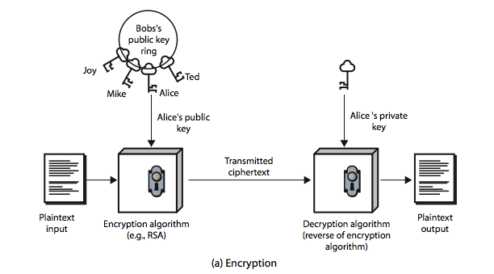
Public-Key Cryptography

Slide 8
Public-Key Characteristics
Public-Key algorithms rely on two keys where:
it is computationally infeasible to find decryption key knowing only algorithm & encryption key
it is computationally easy to en/decrypt messages when the relevant (en/decrypt) key is known
either of the two related keys can be used for encryption, with the other used for decryption (for some algorithms)

Slide 9
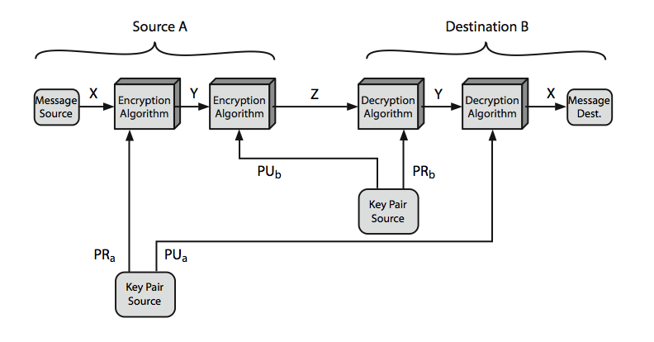
Public-Key Cryptosystems

Slide 10
Public-Key Applications
can classify uses into 3 categories:
encryption/decryption (provide secrecy)
digital signatures (provide authentication)
key exchange (of session keys)
some algorithms are suitable for all uses, others are specific to one

Slide 11
Security of Public Key Schemes
like private key schemes brute force exhaustive search attack is always theoretically possible
but keys used are too large (>512bits)
security relies on a large enough difference in difficulty between easy (en/decrypt) and hard (cryptanalyse) problems
more generally the hard problem is known, but is made hard enough to be impractical to break
requires the use of very large numbers
hence is slow compared to private key schemes

Slide 12
RSA
by Rivest, Shamir & Adleman of MIT in 1977
best known & widely used public-key scheme
based on exponentiation in a finite (Galois) field over integers modulo a prime
nb. exponentiation takes O((log n)³) operations (easy)
uses large integers (eg. 1024 bits)
security due to cost of factoring large numbers
nb. factorization takes O(e ^{log n log log n}) operations (hard)

Slide 13
RSA Key Setup
each user generates a public/private key pair by:
selecting two large primes at random - p, q
computing their system modulus n=p.q
note ø(n)=(p-1)(q-1)
selecting at random the encryption key e
where 1<e<ø(n), gcd(e,ø(n))=1
solve following equation to find decryption key d
e.d=1 mod ø(n) and 0≤d≤n
publish their public encryption key: PU={e,n}
keep secret private decryption key: PR={d,n}

Slide 14
RSA Use
to encrypt a message M the sender:
obtains public key of recipient PU={e,n}
computes: C = Me mod n, where 0≤M<n
to decrypt the ciphertext C the owner:
uses their private key PR={d,n}
computes: M = C^{d} mod n
note that the message M must be smaller than the modulus n (block if needed)

Slide 15
Why RSA Works
because of Euler's Theorem:
a^{ø(n)}mod n = 1 where gcd(a,n)=1
in RSA have:
n=p.q
ø(n)=(p-1)(q-1)
carefully chose e & d to be inverses mod ø(n)
hence e.d=1+k.ø(n) for some k
hence : C^{d} = M^{e.d} = M^{1+k.ø(n)} = M¹.(M^{ø(n)})^{k}
= M¹.(1)^{k} = M¹ = M mod n

Slide 16
RSA Example - Key Setup
Select primes: p=17 & q=11
Compute n = pq =17 x 11=187
Compute ø(n)=(p–1)(q-1)=16 x 10=160
Select e: gcd(e,160)=1; choose e=7
Determine d: de=1 mod 160 and d < 160 Value is d=23 since 23x7=161= 10x160+1
Publish public key PU={7,187}
Keep secret private key PR={23,187}

Slide 17
RSA Example - En/Decryption
sample RSA encryption/decryption is:
given message M = 88 (nb. 88<187)
encryption:
C = 88⁷ mod 187 = 11
decryption:
M = 11²³ mod 187 = 88

Slide 18
Exponentiation
can use the Square and Multiply Algorithm
a fast, efficient algorithm for exponentiation
concept is based on repeatedly squaring base
and multiplying in the ones that are needed to compute the result
look at binary representation of exponent
only takes O(log₂ n) multiples for number n
eg. 7⁵ = 7⁴.7¹ = 3.7 = 10 mod 11
eg. 3¹²⁹ = 3¹²⁸.3¹ = 5.3 = 4 mod 11

Slide 19
Exponentiation
c = 0; f = 1
for i = k downto 0
do c = 2 x c
f = (f x f) mod n
if b_{i} == 1 then
c = c + 1
f = (f x a) mod n
return f

Slide 20
Efficient Encryption
encryption uses exponentiation to power e
hence if e small, this will be faster
often choose e=65537 (2¹⁶-1)
also see choices of e=3 or e=17
but if e too small (eg e=3) can attack
using Chinese remainder theorem & 3 messages with different modulii
if e fixed must ensure gcd(e,ø(n))=1
ie reject any p or q not relatively prime to e

Slide 21
Efficient Decryption
decryption uses exponentiation to power d
this is likely large, insecure if not
can use the Chinese Remainder Theorem (CRT) to compute mod p & q separately. then combine to get desired answer
approx 4 times faster than doing directly
only owner of private key who knows values of p & q can use this technique

Slide 22
RSA Key Generation
users of RSA must:
determine two primes at random - p, q
select either e or d and compute the other
primes p,q must not be easily derived from modulus n=p.q
means must be sufficiently large
typically guess and use probabilistic test
exponents e, d are inverses, so use Inverse algorithm to compute the other

Slide 23
RSA Security
possible approaches to attacking RSA are:
Brute force: This involves trying all possible private keys.
Mathematical attacks: There are several approaches, all equivalent in effort to factoring the product of two primes.
Timing attacks: These depend on the running time of the decryption algorithm.
Chosen ciphertext attacks: This type of attack exploits properties of the RSA algorithm.

Slide 24
Factoring Problem
mathematical approach takes 3 forms:
factor n=p.q, hence compute ø(n) and then d
determine ø(n) directly and compute d
find d directly
currently believe all equivalent to factoring
have seen slow improvements over the years
as of May-05 best is 200 decimal digits (663) bit with LS
biggest improvement comes from improved algorithm
cf QS to GHFS to LS
currently assume 1024-2048 bit RSA is secure
ensure p, q of similar size and matching other constraints

Slide 25
Timing Attacks
developed by Paul Kocher in mid-1990’s
exploit timing variations in operations
eg. multiplying by small vs large number
or IF's varying which instructions executed
infer operand size based on time taken
RSA exploits time taken in exponentiation
countermeasures
use constant exponentiation time
add random delays
blind values used in calculations

Slide 26
Chosen Ciphertext Attacks
- RSA is vulnerable to a Chosen Ciphertext Attack (CCA)
- Attackers chooses ciphertexts & gets decrypted plaintext back
- Choose ciphertext to exploit properties of RSA to provide info to help cryptanalysis
- To counter with random pad of plaintext
or use Optimal Asymmetric Encryption Padding (OASP)

Slide 27
Diffie-Hellman Key Exchange
The purpose of the algorithm is to enable two users to securely exchange a key that can then be used for subsequent encryption of messages.
The algorithm itself is limited to the exchange of secret values.

Slide 28

Diffie-Hellman key exchange algorithm
For this scheme, there are two publicly known numbers: a prime number and an integer α that is a primitive root of .
Suppose the users A and B wish to exchange a key.
User A selects a random integer XA < q and computes

Slide 29



Similarly, user B independently selects a random integer XB < q and computes
Each side keeps the X value private and makes the Y value available publicly to the other side.
User A computes the key as
and user B computes the key as
These two calculations produce identical results

Slide 30
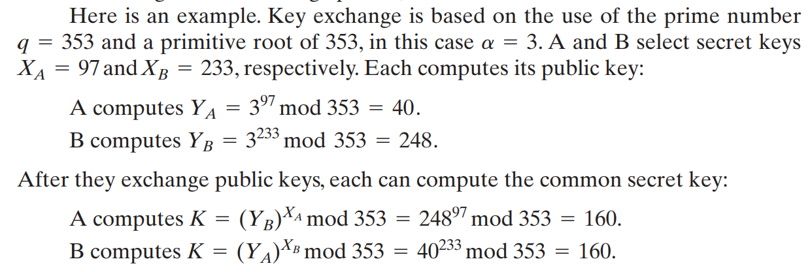
Example

Slide 31
To assume an attacker would have available the following information:
q = 353; a = 3; YA = 40; YB = 248
In this simple example, it would be possible by brute force to determine the secret key 160.
In particular, an attacker E can determine the common key by discovering a solution to the equation

Slide 32

The brute-force approach is to calculate powers of 3 modulo 353, stopping when the result equals either 40 or 248.
The desired answer is reached with the exponent value of 97, which provides
With larger numbers, the problem becomes impractical.

Slide 33
Key Exchange Protocols
Suppose that user A wishes to set up a connection with user B and use a secret key to encrypt messages on that connection.
User A can generate a one-time private key XA , calculate YA, and send that to user B. User B responds by generating a private value XB, calculating YB, and sending YB to user A.
Both users can now calculate the key. The necessary public values q and ɑ would need to be known ahead of time. Alternatively, user A could pick values for q and ɑ and include those in the first message.

Slide 34
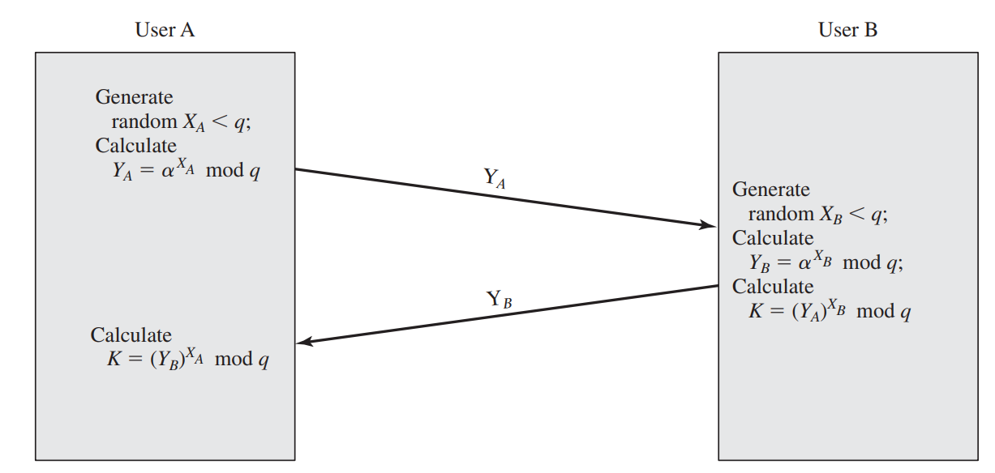
Key Exchange Protocols

Slide 35
Man-in-the-Middle Attack
The protocol represent in previous slide is insecure against a man-in-the-middle attack.
Suppose Alice and Bob wish to exchange keys, and Darth is the adversary.

Slide 36
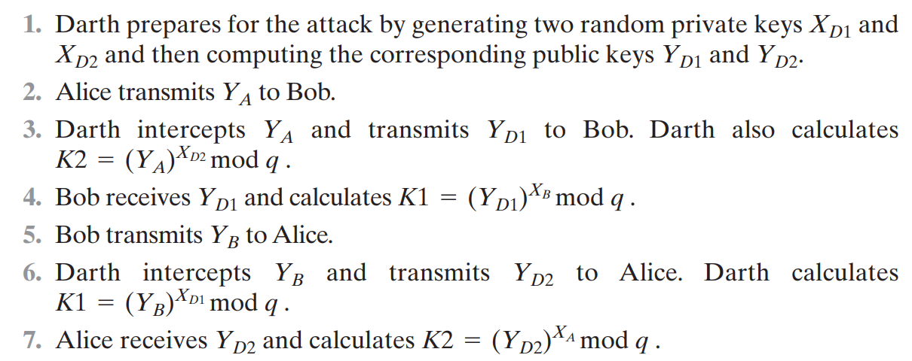
The attack proceeds as follows.

Slide 37
At this point, Bob and Alice think that they share a secret key, but instead Bob and Darth share secret key and Alice and Darth share secret key .
All future communication between Bob and Alice is compromised in the following way.
1. Alice sends an encrypted message .
2. Darth intercepts the encrypted message and decrypts it to recover .
3. Darth sends Bob , where is any message.

Slide 38
In the first case, Darth simply wants to eavesdrop on the communication without altering it.
In the second case, Darth wants to modify the message going to Bob.
The key exchange protocol is vulnerable to such an attack because it does not authenticate the participants.
This vulnerability can be overcome with the use of digital signatures and public-key certificates;

Slide 39
Cryptographic Hash Function
A hash function H accepts a variable-length block of data as input and produces a fixed-size hash value
h = H(M)
A “good” hash function has the property that the results of applying the function to a large set of inputs will produce outputs that are evenly distributed and apparently random.
In general terms, the principal object of a hash function is data integrity.
A change to any bit or bits in results, with high probability, in a change to the hash code.

Slide 40
The kind of hash function needed for security applications is referred to as a cryptographic hash function
A cryptographic hash function is an algorithm for which it is computationally infeasible (because no attack is significantly more efficient than brute force) to find either
a data object that maps to a pre-specified hash result (the one-way property) or
two data objects that map to the same hash result (the collision-free property).

Slide 41
Because of these characteristics, hash functions are often used to determine whether or not data has changed.
The general operation of a cryptographic hash function.
Typically, the input is padded out to an integer multiple of some fixed length (e.g., 1024 bits), and the padding includes the value of the length of the original message in bits.

Slide 42
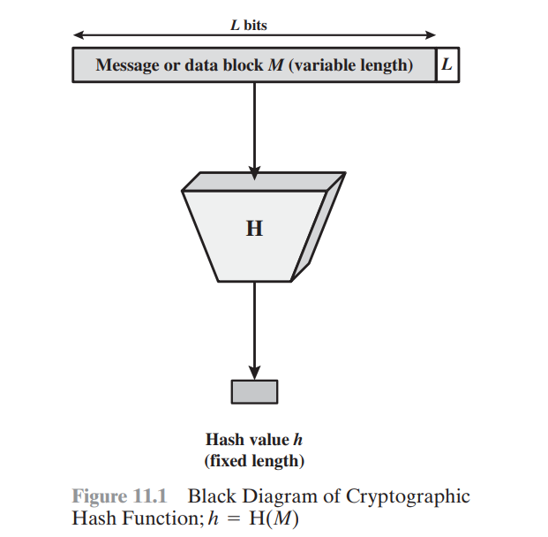
The length field is a security measure to increase the difficulty for an attacker to produce an alternative message with the same hash value.

Slide 43
Secure Hash Algorithm (SHA)
SHA was developed by the National Institute of Standards and Technology (NIST) and published as a federal information processing standard (FIPS 180) in 1993.
The actual standards document is entitled “Secure Hash Standard.” SHA is based on the hash function MD4, and its design closely models MD4.
SHA-1 produces a hash value of 160 bits

Slide 44
SHA-512 Logic
The algorithm takes as input a message with a maximum length of less than 2¹²⁸ bits and produces as output a 512-bit message digest.
The input is processed in 1024-bit blocks

Slide 45
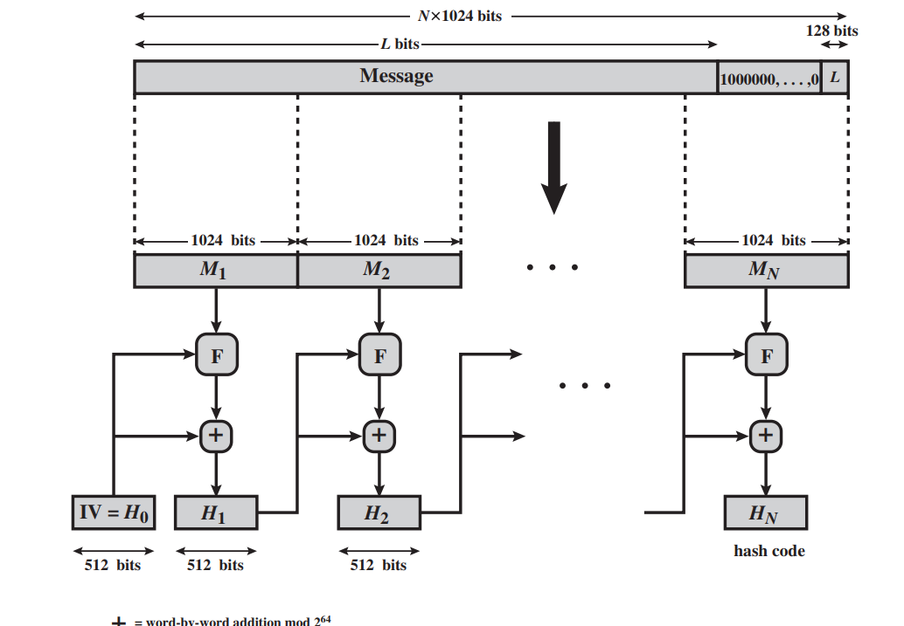
Message Digest Generation Using SHA-512

Slide 46

The processing consists of the following steps.
Step 1 Append padding bits.
The message is padded so that its length is congruent to 896 modulo 1024
Padding is always added, even if the message is already of the desired length.
Thus, the number of padding bits is in the range of 1 to 1024.
The padding consists of a single 1 bit followed by the necessary number of 0 bits.

Slide 47
Step 2 Append length.
A block of 128 bits is appended to the message.
This block is treated as an unsigned 128-bit integer (most significant byte first) and contains the length of the original message (before the padding).
The outcome of the first two steps yields a message that is an integer multiple of 1024 bits in length.
The expanded message is represented as the sequence of 1024-bit blocks M1, M2,….MN, so that the total length of the expanded message is N X 1024bits .

Slide 48
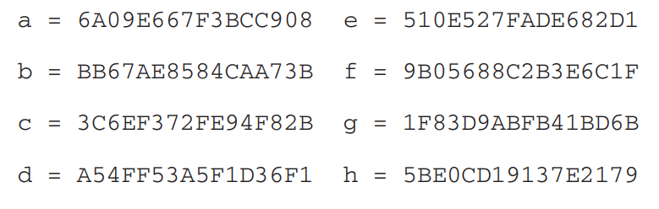
Step 3 Initialize hash buffer.
A 512-bit buffer is used to hold intermediate and final results of the hash function.
The buffer can be represented as eight 64-bit registers (a, b, c, d, e, f, g, h).
These registers are initialized to the following 64-bit integers (hexadecimal values):

Slide 49
These values are stored in big-endian format, which is the most significant byte of a word in the low-address (leftmost) byte position.
These words were obtained by taking the first sixty-four bits of the fractional parts of the square roots of the first eight prime numbers.

Slide 50
Step 4 Process message in 1024-bit (128-word) blocks. The heart of the algorithm is a module that consists of 80 rounds; this module is labeled F

Slide 51
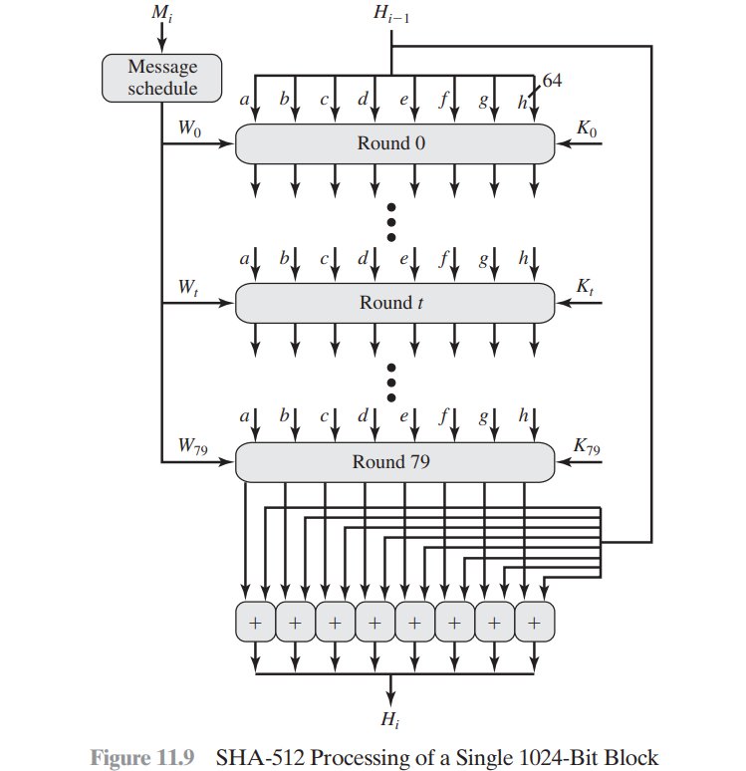

Slide 52
Each round takes as input the 512-bit buffer value, abcdefgh, and updates the contents of the buffer.
At input to the first round, the buffer has the value of the intermediate hash value, Hi-1.
Each round makes use of a 64-bit value Wt, derived from the current 1024-bit block being processed(Mi).
These values are derived using a message schedule described subsequently.
Each round also makes use of an additive constant Kt, where 0<= t <= 79 indicates one of the 80 rounds.

Slide 53
These words represent the first 64 bits of the fractional parts of the cube roots of the first 80 prime numbers.
The constants provide a “randomized” set of 64-bit patterns, which should eliminate any regularities in the input data

Slide 54
Step 5 Output.
After all 1024-bit blocks have been processed, the output from the Nth stage is the 512-bit message digest.

Slide 55
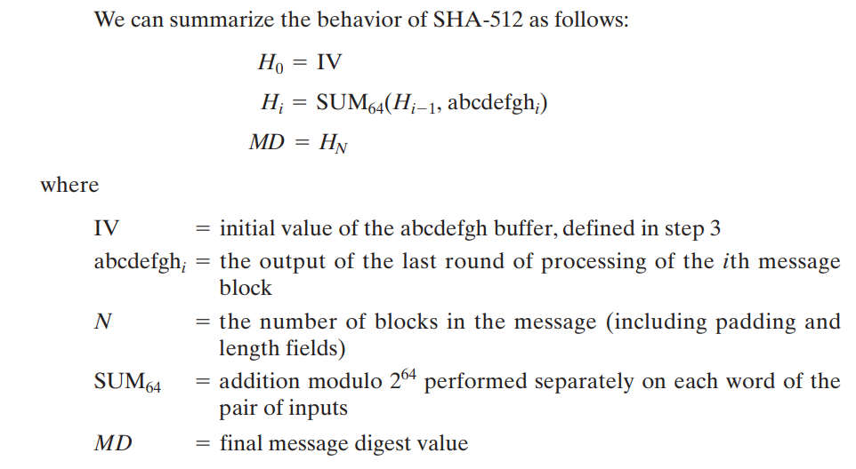

Slide 56
Message Authentication Code
Message authentication is a mechanism or service used to verify the integrity of a message.
Symmetric encryption provides authentication among those who share the secret key.
A message authentication code (MAC) is an algorithm that requires the use of a secret key. A MAC takes a variable-length message and a secret key as input and produces an authentication code. A recipient in possession of the secret key can generate an authentication code to verify the integrity of the message.

Slide 57
Message Authentication Requirement
In the context of communications across a network, the following attacks can be identified.
Disclosure: Release of message contents to any person or process not possessing the appropriate cryptographic key.
2. Traffic analysis: Discovery of the pattern of traffic between parties. In a connection-oriented application, the frequency and duration of connections could be determined. In either a connection-oriented or connectionless environment, the number and length of messages between parties could be determined.

Slide 58
3. Masquerade: Insertion of messages into the network from a fraudulent source.
This includes the creation of messages by an opponent that are purported to come from an authorized entity.
Also included are fraudulent acknowledgments of message receipt or nonreceipt by someone other than the message recipient.

Slide 59
4. Content modification: Changes to the contents of a message, including insertion, deletion, transposition, and modification.
5. Sequence modification: Any modification to a sequence of messages between parties, including insertion, deletion, and reordering.

Slide 60
6. Timing modification: Delay or replay of messages.
In a connection-oriented application, an entire session or sequence of messages could be a replay of some previous valid session, or individual messages in the sequence could be delayed or replayed.
In a connectionless application, an individual message (e.g., datagram) could be delayed or replayed.

Slide 61
7. Source repudiation: Denial of transmission of message by source.
8. Destination repudiation: Denial of receipt of message by destination.

Slide 62
Message Authentication Functions
• Hash function: A function that maps a message of any length into a fixed length hash value, which serves as the authenticator
• Message encryption: The ciphertext of the entire message serves as its authenticator
• Message authentication code (MAC): A function of the message and a secret key that produces a fixed-length value that serves as the authenticator

Slide 63
Message Authentication Code
An authentication technique involves the use of a secret key to generate a small fixed-size block of data, known as a cryptographic checksum or MAC, that is appended to the message.
This technique assumes that two communicating parties, say A and B, share a common secret key.
When A has a message to send to B, it calculates the MAC as a function of the message and the key:
MAC = MAC(K, M)

Slide 64
Where
M = Input message
C = MAC function
K = Shared secret key
MAC = Message Authentication Code
The message plus MAC are transmitted to the intended recipient.
The recipient performs the same calculate generate a new MAC.
The received MAC is compared to the calculated MAC.
To assume that only the receiver and the sender know the identity of the secret key, and if the received MAC matches the calculated MAC

Slide 65
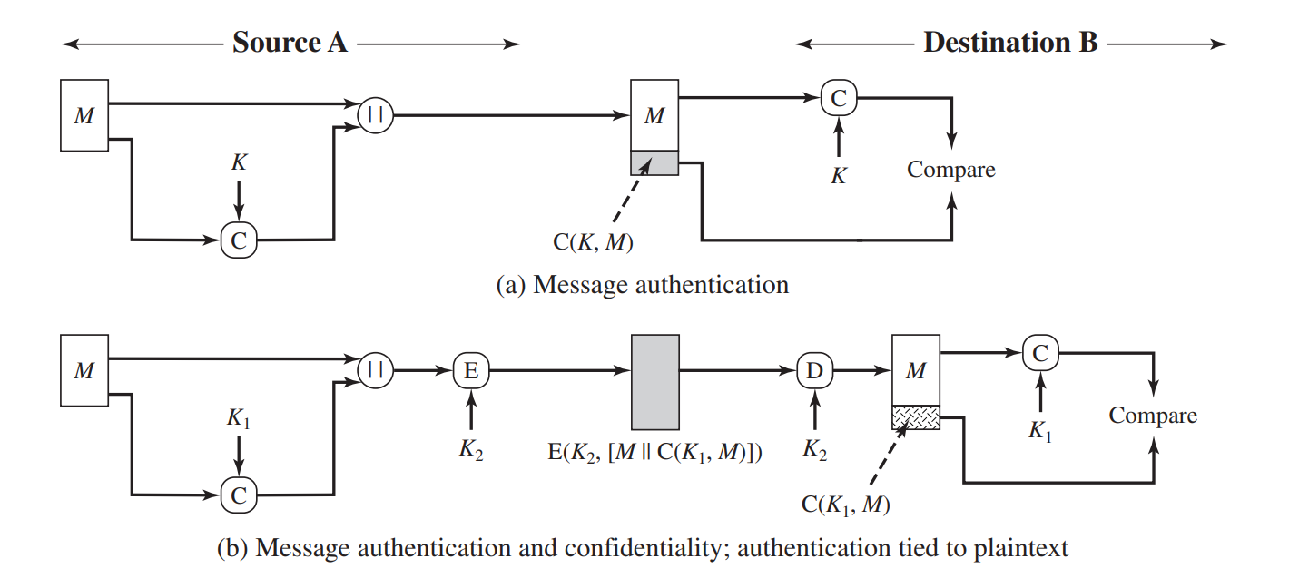

Slide 66
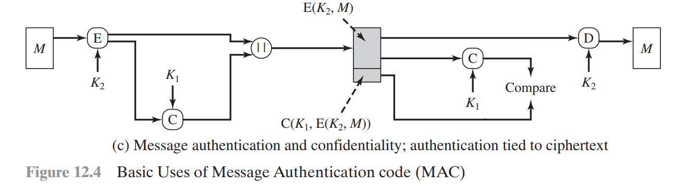

Slide 67
The receiver is assured that the message has not been altered.
If an attacker alters the message but does not alter the MAC, then the receiver’s calculation of the MAC will differ from the received MAC.
Because the attacker is assumed not to know the secret key, the attacker cannot alter the MAC to correspond to the alterations in the message.

Slide 68
The receiver is assured that the message is from the alleged sender. Because no one else knows the secret key, no one else could prepare a message with a proper MAC.
If the message includes a sequence number (such as is used with HDLC, X.25, and TCP), then the receiver can be assured of the proper sequence because an attacker cannot successfully alter the sequence number.

Slide 69
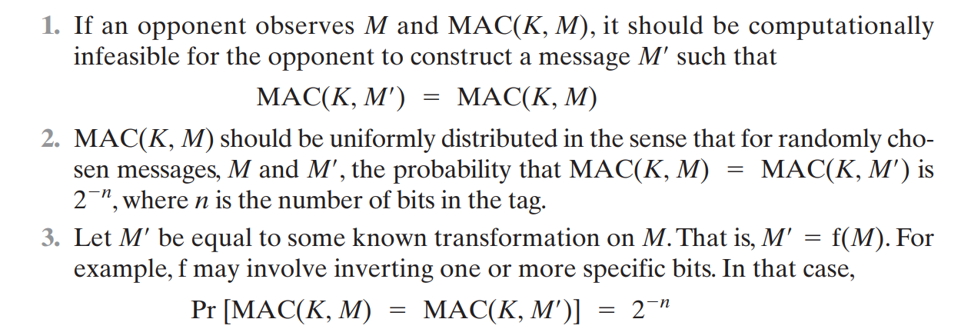
Requirement for MAC
The MAC function should satisfy the following requirements

Slide 70
Security of MACS
Brute-Force Attacks
A brute-force attack on a MAC is a more difficult undertaking than a brute-force attack on a hash function because it requires known message-tag pairs
Cryptanalysis
Cryptanalytic attacks on MAC algorithms seek to exploit some property of the algorithm to perform some attack other than an exhaustive search.

Slide 71
MACs Based on Hash Function: HMAC
In recent years, there has been increased interest in developing a MAC derived from a cryptographic hash function.
The motivations for this interest are
Cryptographic hash functions such as MD5 and SHA generally execute faster in software than symmetric block ciphers such as DES.
2. Library code for cryptographic hash functions is widely available.

Slide 72
HMAC Design Objectives
To use, without modifications, available hash functions. In particular, to use hash functions that perform well in software and for which code is freely and widely available.
To allow for easy replaceability of the embedded hash function in case faster or more secure hash functions are found or required.
To preserve the original performance of the hash function without incurring a significant degradation.
To use and handle keys in a simple way.
To have a well understood cryptographic analysis of the strength of the authentication mechanism based on reasonable assumptions about the embedded hash function.

Slide 73
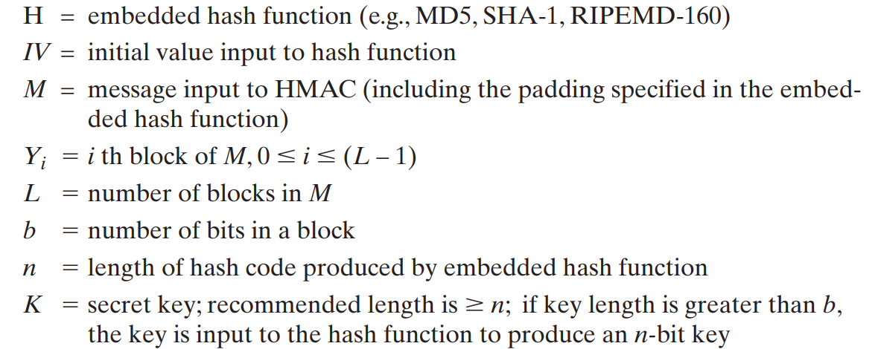
HMAC Algorithm
The overall operation of HMAC. Define the following terms

Slide 74
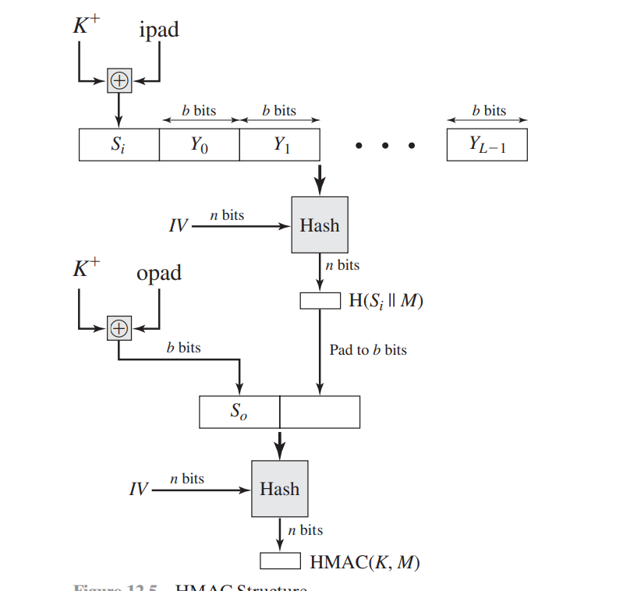
HMAC Structure

Slide 75
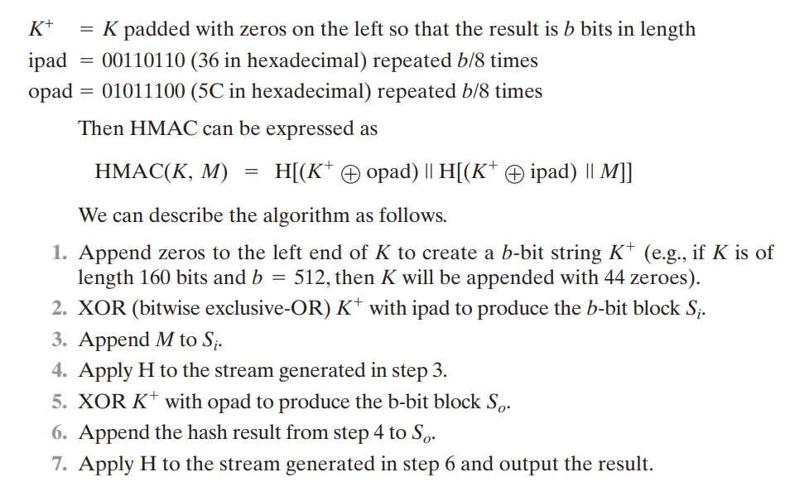

Slide 76
DIGITAL SIGNATURES
Properties
Message authentication protects two parties who exchange messages from any third party.
However, it does not protect the two parties against each other.
Several forms of dispute between the two are possible

Slide 77
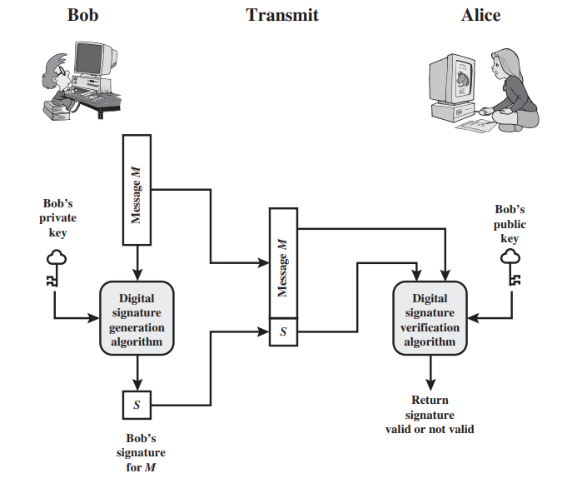
Generic Model of Digital Signature Process

Slide 78
A digital signature is an authentication mechanism that enables the creator of a message to attach a code that acts as a signature.
Typically the signature is formed by taking the hash of the message and encrypting the message with the creator’s private key.
The signature guarantees the source and integrity of the message.
The digital signature standard (DSS) is an NIST standard that uses the secure hash algorithm (SHA).

Slide 79
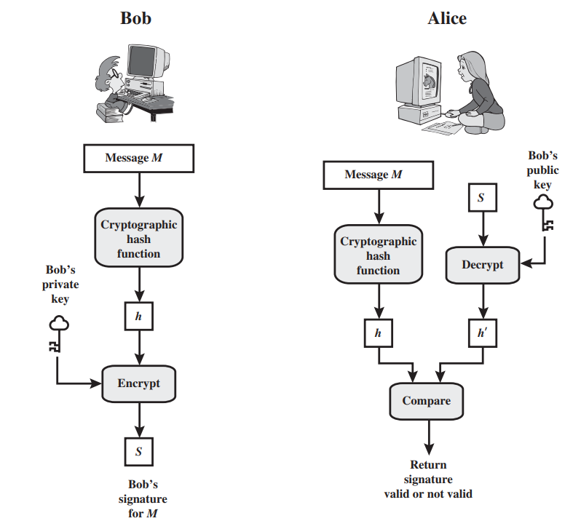
Simplified Depiction of Essential Elements of Digital Signature Process

Slide 80
The digital signature must have the following properties:
It must verify the author and the date and time of the signature.
It must authenticate the contents at the time of the signature.
It must be verifiable by third parties, to resolve disputes.

Slide 81
Attacks and Forgeries
Key-only attack: C only knows A’s public key.
Known message attack: C is given access to a set of messages and their signatures.
Generic chosen message attack: C chooses a list of messages before attempting to breaks A’s signature scheme, independent of A’s public key. C then obtains from A valid signatures for the chosen messages. The attack is generic, because it does not depend on A’s public key; the same attack is used against everyone.
Directed chosen message attack: Similar to the generic attack, except that the list of messages to be signed is chosen after C knows A’s public key but before any signatures are seen.
Adaptive chosen message attack: C is allowed to use A as an “oracle.” This means the A may request signatures of messages that depend on previously obtained message–signature pairs.

Slide 82
Total break: C determines A’s private key.
Universal forgery: C finds an efficient signing algorithm that provides an equivalent way of constructing signatures on arbitrary messages.
Selective forgery: C forges a signature for a particular message chosen by C.
Existential forgery: C forges a signature for at least one message. C has no control over the message. Consequently, this forgery may only be a minor nuisance to A.

Slide 83
Digital Signature Requirements
The signature must be a bit pattern that depends on the message being signed.
The signature must use some information unique to the sender to prevent both forgery and denial.
It must be relatively easy to produce the digital signature.
It must be relatively easy to recognize and verify the digital signature.
It must be computationally infeasible to forge a digital signature, either by constructing a new message for an existing digital signature or by constructing a fraudulent digital signature for a given message.
It must be practical to retain a copy of the digital signature in storage

Slide 84
Direct Digital Signature
The term direct digital signature refers to a digital signature scheme that involves only the communicating parties (source, destination).
It is assumed that the destination knows the public key of the source

Slide 85


